Slide 1
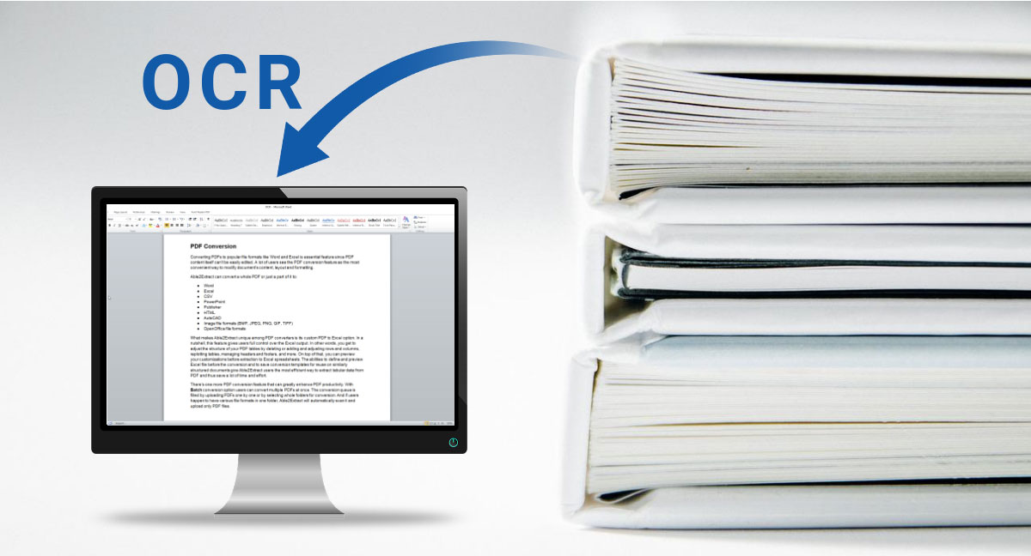
OPTICAL CHARACTER RECOGNITION
Y RAVI TEJA 9918004165
M SAINATH 9918004162

Slide 2
INTRODUCTION
This ppt gives an idea about how to make the picture text into Digital text. It is done
by scanning the picture text and converting them by a CNN model
By implementing this project we can make picture documents into usable document
without any human help
For this purpose government is recruiting the people to convert these documents, and to finish
the task efficiently and quickly without any error we can make use of this project
If we want to solve any mathematical expression with the aid of any artificial machine we have to enter the numericals and symbols ourselves which may result in any manual errors but by scanningthe expression with CNN model it understands the expression and knows the property of each symbol and executes the expression in fraction of seconds without any error

Slide 3
SPECIFICATIONS
HARDWARE= Camera
(ii)System requirments
SOFTWARE= (i) A python shell with fully installed libraries like keras,matplot,imutils,scikit-learn in it and should have a
GUI for better experience(API keys also used in minor portions)
(ii)A data set of letters and numbers which we want to convert (in thousands)

Slide 4
PROPOSED SYSTEM
This is achieved by creating a data set , for the respective language and train it for converting the images and we can add these java jar files to our java build path in any of the java ide like eclipse or Netbeans.We can create the data set by taking the images of the data we want to predict with the help of this model and one letter should be snapped many times for correct accuracy of prediction
Actually we should know what is the meaning for Optical character recognition (OCR) method has been used in
converting printed text into editable text. OCR is very useful and popular method in various applications. Accuracy of OCR can be dependent on text preprocessing and segmentation algorithms.
Optical character Recognition (OCR) is a conversion of scanned or printed text images [1], handwritten text into
editable text for further processing. This technology allows machine to recognize the text automatically. It is like
combination of eye and mind of human body. An eye can view the text from the images but actually the brain processes as well as interprets that extracted text read by eye

Slide 5
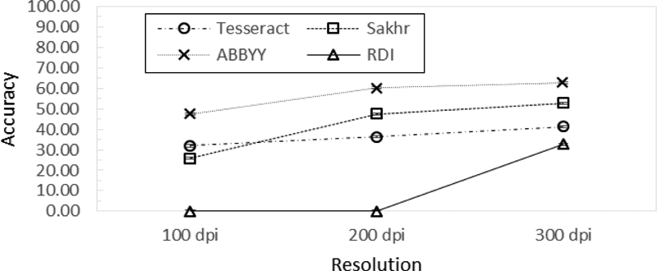
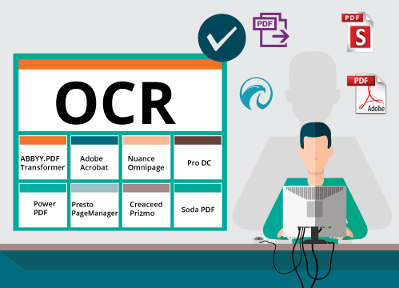

Slide 6
MODULES
Creating the data set with our required language
Implementing and installing them into our java build path
Performance Analyzing and Training of the data set with some inputs
ACTIVITY PLAN
MARCH-1 | Creation of the data set
MARCH-8 | Building a trained data set of language
MARCH-20 | Training the data set
MARCH-28 | Make predictions on new data using different inputs

Slide 7
REFERENCES
OCR CONCEPT LINK
https://en.wikipedia.org/wiki/Tesseract_(software)
PROJECT REFERENCE
https://github.com/yamsani-raviteja/OCR-with-java.git
BOOK I REFERRED FOR THIS PROJECT
Guide for OCR for indic Scripts

Slide 8
THANK YOU ONE AND ALL

